Slide 1
High value customers identification for an E-Commerce company
simplilearn data science assignment.

Slide 2
SUMMARY
INTRODUCTION
DATA EXPLORATION
DATA TRANSFORMATION
MODEL DEVELOPMENT
INTERPRETATION

Slide 3
INTRODUCTION
Background of Problem Statement:
A UK-based online retail store has captured the sales data for different products for the period of one year (Nov 2016 to Dec 2017). The organization sells gifts primarily on the online platform. The customers who make a purchase consume directly for themselves. There are small businesses that buy in bulk and sell to other customers through the retail outlet channel.
Project Objective:
Find significant customers for the business who make high purchases of their favourite products. The organization wants to roll out a loyalty program to the high-value customers after identification of segments. Use the clustering methodology to segment customers into groups:
Domain: E-commerce

Slide 4
DATA EXPLORATION
Dataset Description:
This is a transnational dataset that contains all the transactions occurring between Nov-2016 to Dec-2017 for a UK-based online retail store.
Variables:
Attribute Description
InvoiceNo Invoice number (A 6-digit integral number uniquely assigned to each transaction)
StockCode Product (item) code
Description Product (item) name
Quantity The quantities of each product (item) per transaction
InvoiceDate The day when each transaction was generated
UnitPrice Unit price (Product price per unit)
CustomerID Customer number (Unique ID assigned to each customer)
Country Country name (The name of the country where each customer resides)

Slide 5
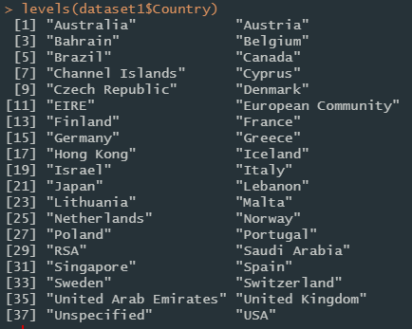
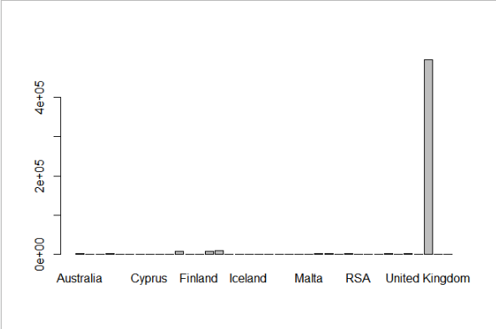
The dataset contains 38 countries data
More than 80% of our data come from UK so for the purpose of our analysis we will only focus on data from UK.
Missing data have been removed as we have enough data and assumed that removing them would be better than replacing them.
Duplicate rows have also been removed so the analysis wont be biased

Slide 6
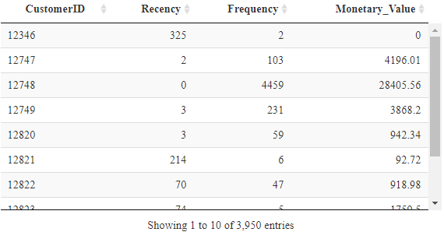
DATA TRANSFORMATION
For this analysis we will use the RFM( recency, frequency, monetary) method to evaluated our clients
The recency is calculated as time of customer’s last purchase minus the last transaction date in days
Frequency was calculated counting the number of times a customer has made a transaction with the Online Retailer in a year
Monetary refers to the total sum of revenue generated by the user over the course of a year. It has been estimated calculating the Unit Price and Quantity per transaction and grouping by CustomerID.

Slide 7
MODEL DEVELOPMENT
K-Means
K-means is a centroid-based algorithm, or a distance-based algorithm, where we calculate the distances to assign a point to a cluster. In K-Means, each cluster is associated with a centroid.
Hierechical clustering
To enhance this clustering analysis it was decided to further segment the largest cluster of customer in the first segementation (Cluster 3), this further sub-segmentation was performed using hierechical clustering to further understand the customers the characteristics of this group.

Slide 8
K-MEANS
The number of cluster was set to 3 after using the silhouette method.
These 3 clusters can be consider as low, medium, and high value customers.
3 clusters have been constrcuted based on the following features:
Recency (Days of inactiviy)
Frequency (Number of purchases)
Monetary Value (Revenue generated).

Slide 9
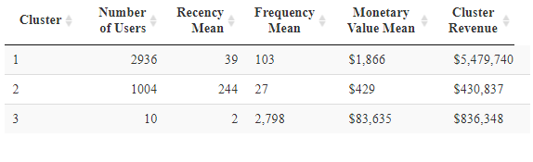
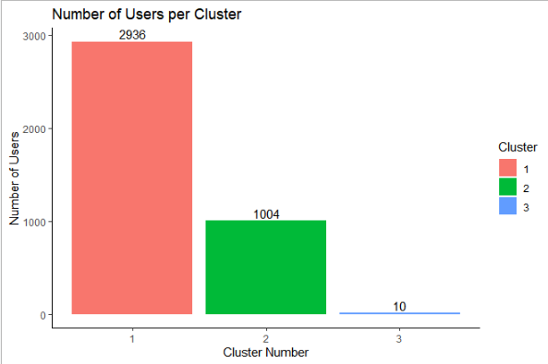
cluster1: These are the medium value customers with 2936 members, average of 39 days of inactivity with an average of 103 purchase in a year and an average revenu of 1,866$. This cluster has the highest revenue for this year with 5,479,740$
cluster2: These are the low value customerswith 1004 members, average of 244 days of inactivity with an average of 27 purchase in a year and an average revenu of 429$. This cluster has 430,087$
cluster3: These are the high value customers with 10 members, average of 2 days of inactivity with an average of 2798 purchase in a year and an average revenu of 83,635$. This cluster revenue is 836,348$

Slide 10
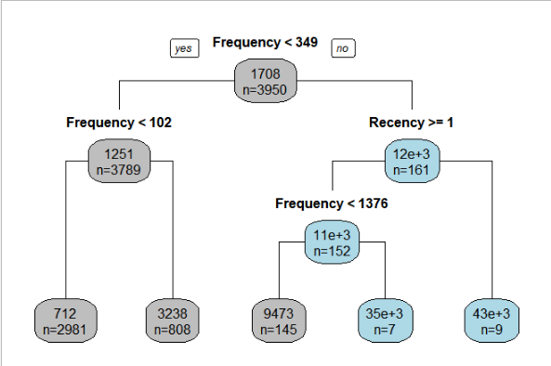
Hiererchical Clustering
How to read the graph :
Read the statement on top of the model and move right for “no” or left for “yes”.
The top number in the bubble represents the average monetary value for the group
n = represents the number of variables that are part of the group

Slide 11
INTERPRETATION
This sub-segmentation of Cluster , divided the segment into 5 smaller different clusters.
Results: (From low value to high value customers)
2981 customers that purchase less than 102 times, average monetary value of $712.
808 customers that purchase more than 102 times, average monetary value of $3,238 (Significantly higher than the previous group)
145 customers that purchase less than 1376 times and have not purchased in the last 1 or more days. Average Monetary Value of $9,473.
7 customers that purchase more than 1376 times and have not purchased in the last 1 or more days. Average Monetary Value around $35000.
9 customers that have purchased within the last 1 days. Highest average monetary value around $43000.
This last sub-segment of 9 customers represents the most valuable customers . From these insights, executive and management team can take further strategic actions to increase the averague monetary value of lower sub-segments within this cluster of customers.

Slide 12
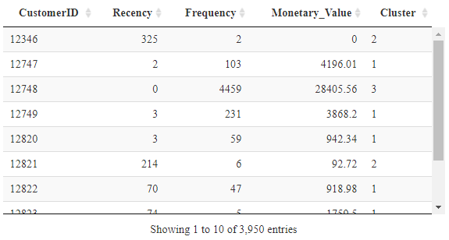
Final table

